Slide 1

YOUR LOGO
Summary of cutting-edge technologies and applications of artificial intelligence

Slide 2

CONTENTS
Artificial Intelligence Overview and Development Trends
01
Deep Learning Fundamentals and Applications
02
Reinforcement Learning Principles and Practice
03
Evolutionary Computation and Systems
04
Introduction to Graph Neural Networks and Case Studies
05

Slide 3
目录
CONTENTS
06
Federated Learning and Data Privacy Protection
07
Quantum Computing and Intelligent Computing Convergenc
08
Big Data Modeling and Analysis Methods
09
Intelligent Systems Integrated Design Case Studies

Slide 4


YOUR LOGO
01
Artificial Intelligence Overview and Development Trends

Slide 5
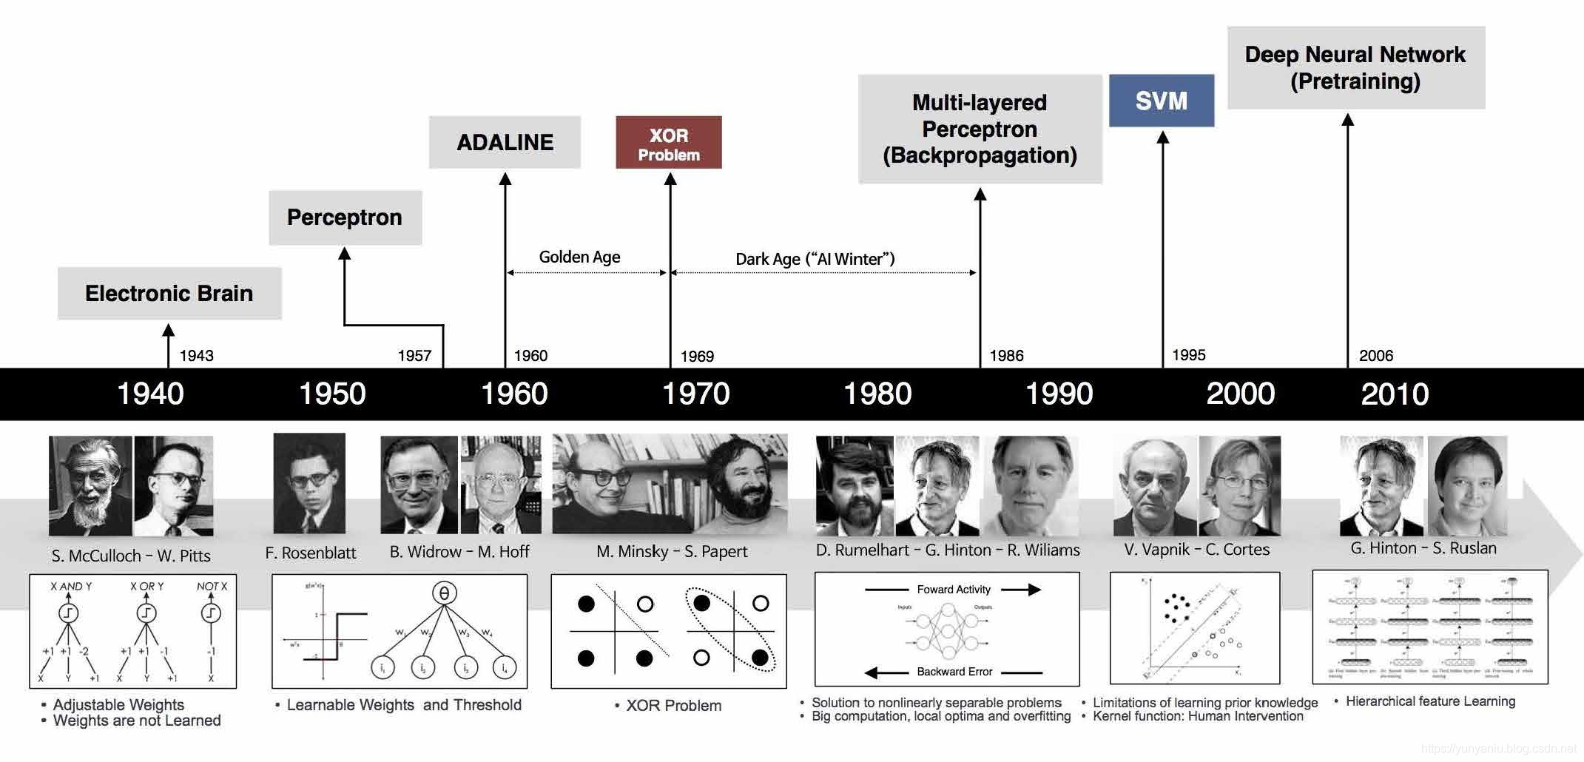
History of AI
Early Beginnings
Major Milestones
Modern Developments
The concept of AI dates back to ancient myths and stories of artificial beings endowed with intelligence. However, the field of AI as we know it today began in the 1950s. The Dartmouth Conference in 1956 is often considered the birth of AI, where a group of scientists gathered to discuss the possibility of creating machines that could think like humans.
Over the years, there have been several major milestones in AI. In the 1960s, the first AI programs were developed, including the General Problem Solver and the Logic Theorist. In the 1970s, expert systems emerged, which were designed to solve complex problems in specific domains. The 1980s saw the rise of machine learning, with algorithms such as decision trees and neural networks being developed.
In recent years, AI has made significant progress, driven by advances in computing power and the availability of large amounts of data. Deep learning, a subfield of machine learning, has achieved remarkable success in areas such as image and speech recognition. AI is now being applied in various fields, including healthcare, finance, transportation, and entertainment.

Slide 6
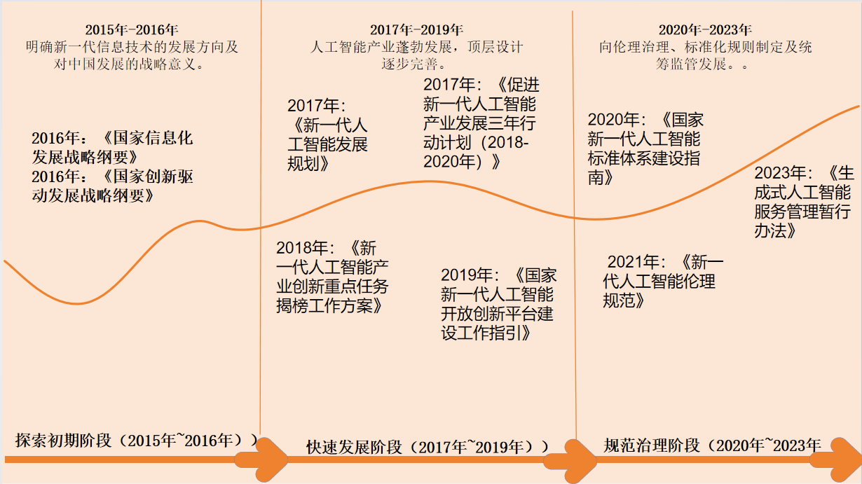
History of AI In China

Slide 7
YOUR LOGO
02
Deep Learning Fundamentals and Applications

Slide 8
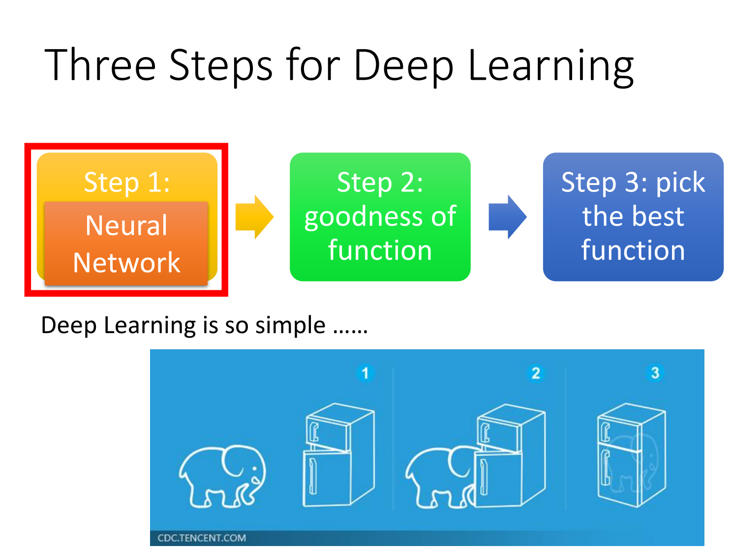
Deep Learning

Slide 9
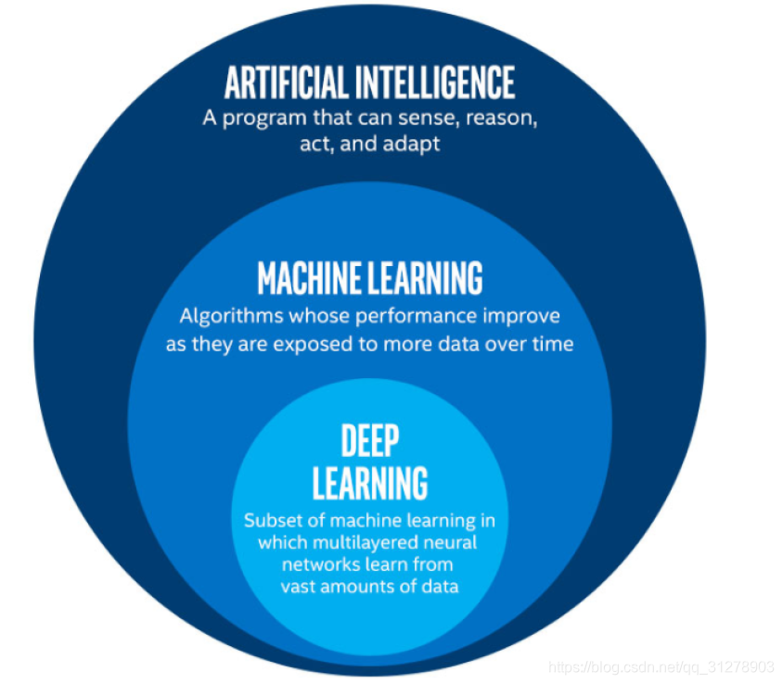
An intuitive understanding of deep learning
Deep Learning (DL) addresses the fundamental bottleneck of manual feature engineering in traditional Machine Learning (ML) by enabling automatic, hierarchical feature learning directly from raw data.

Slide 10
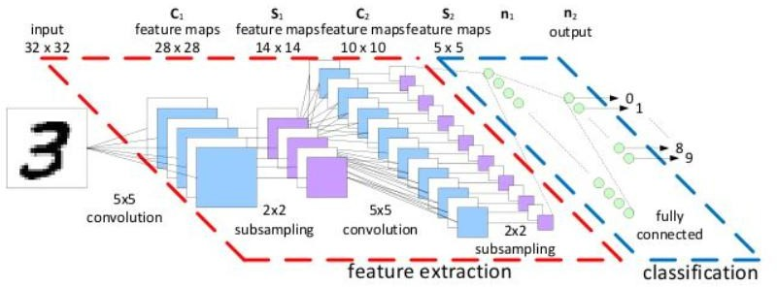
Why do you need deep learning?
Deep Learning: Feature Extraction Methods:
Deep Learning: Automatic Feature Learning
Neural networks hierarchically learn features directly from raw data
Shallow layers: Basic features (e.g., edges, textures)
Middle layers: Composite features (e.g., object parts)
Deep layers: Abstract features (e.g., holistic objects, semantics)
Requires no manual intervention; optimized end-to-end.
Deep learning automatically extracts complex, task-adaptive features through hierarchical abstraction.

Slide 11
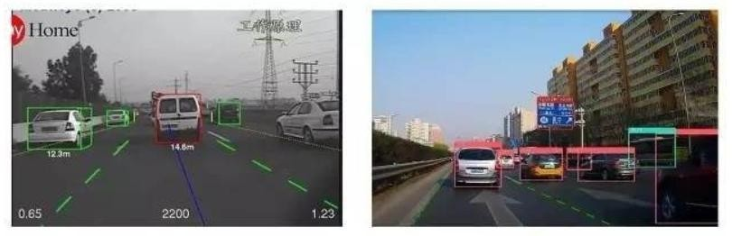
Applications: Self-driving cars recognizing traffic lights and pedestrians; Technology: CNN (Convolutional Neural Network) identifies edges, shapes, and semantic objects from pixels through multi-layer feature extraction.
Applications of Deep Learning

Slide 12
YOUR LOGO
03
Reinforcement Learning Principles and Practice

Slide 13
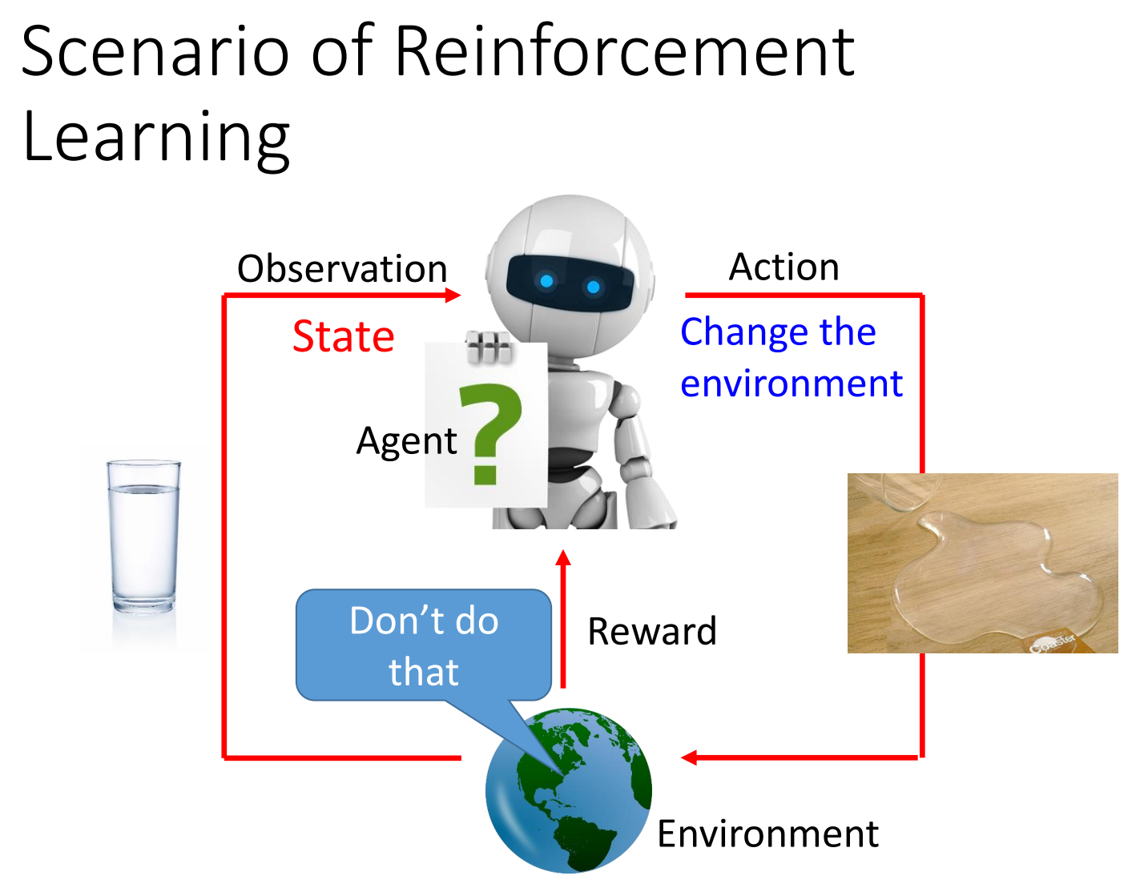
Reinforcement learning

Slide 14

Definition and Basic Concepts
Definition of Reinforcement Learning
Reinforcement learning is a type of machine learning where an agent learns to make decisions by taking actions in an environment to maximize some notion of cumulative reward. It differs from supervised learning as it does not require labeled data and from unsupervised learning as it has clear goals and feedback mechanisms.
Key Elements: Agent, Environment, and Reward
Applications of Reinforcement Learning
In reinforcement learning, the agent is the decision-maker or learner. The environment is everything that the agent interacts with. The reward signal is the feedback from the environment that guides the agent's actions. The agent's goal is to maximize the cumulative reward over time.
Reinforcement learning has a wide range of applications, including robotics for tasks like navigation and manipulation, gaming to develop intelligent game-playing agents, and recommendation systems to personalize content for users. It is also used in finance for portfolio management and in healthcare for treatment planning.

Slide 15
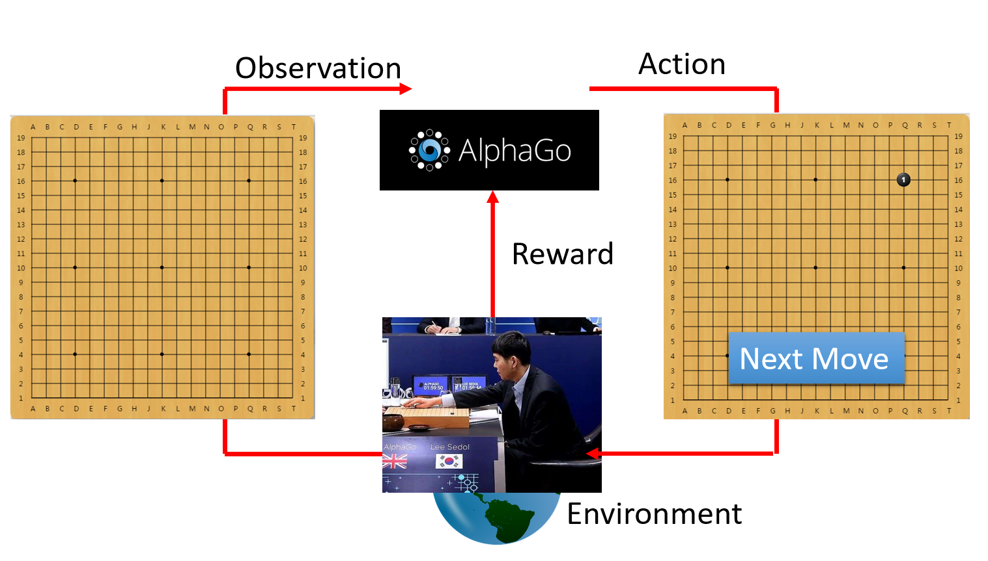
Example

Slide 16

Summary of Reinforcement Learning
Key Concepts and Methods
Reinforcement learning is a powerful approach to machine learning that involves an agent learning to make decisions in an environment to maximize cumulative reward. Key concepts include the agent, environment, reward, value functions, and policies. Methods such as dynamic programming, Monte Carlo methods, temporal-difference learning, and deep reinforcement learning have been developed to solve reinforcement learning problems.
Applications and Impact
Reinforcement learning has a wide range of applications in various fields, including robotics, gaming, finance, healthcare, and entertainment. It has led to significant advancements in these areas and has the potential to transform many industries. The impact of reinforcement learning is expected to grow as the technology continues to develop and mature.

Slide 17
YOUR LOGO
04
Evolutionary Computation and Systems

Slide 18
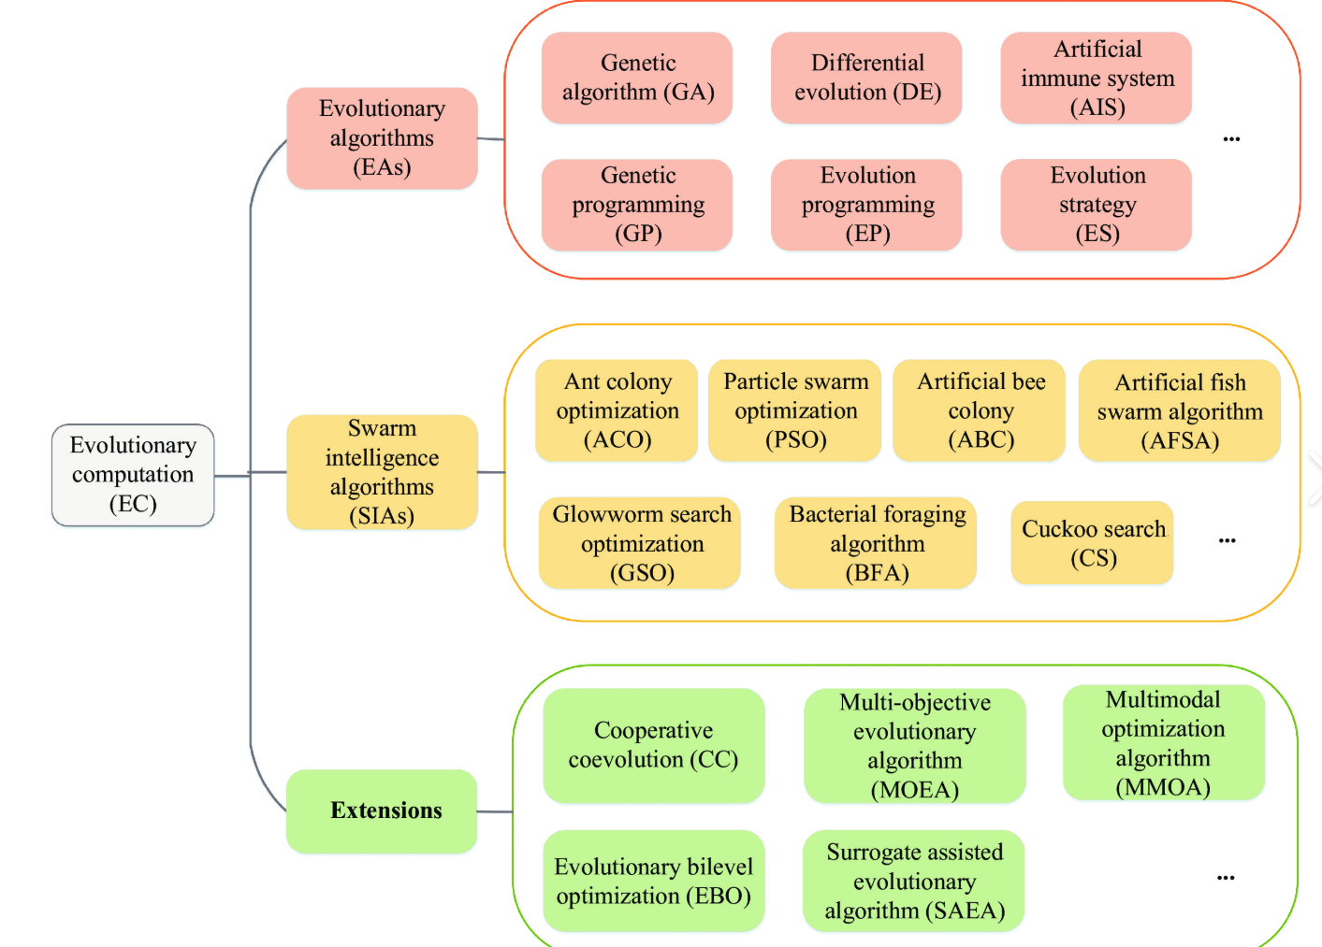
Evolutionary Computation and Systems
Evolutionary Computation (EC) is a family of population-based optimization algorithms inspired by biological evolution, including natural selection, mutation, recombination, and inheritance.

Slide 19
​​Introduction to Evolutionary Computation
Definition: A stochastic search and optimization method based on natural selection and genetic mechanisms.
Historical Development:
1950s: Emergence of genetic algorithm concepts (Holland)
1970s–1990s: Development of evolution strategies (Rechenberg), genetic programming, and other evolutionary algorithms
2000s–Present: Multi-objective optimization, hybrid intelligence, integration with deep learning

Slide 20
​​General Workflow Framework
Initialize Population
The basic steps of an evolutionary algorithm are:
Initialize Population: Randomly create a set of candidate solutions.
Evaluate Fitness: Measure how good each individual is.
Selection: Choose the better individuals for reproduction.
Crossover: Combine parents to generate offspring.
Mutation: Introduce small random changes to maintain diversity.
Update Population: Form a new generation of individuals.
Termination Check: Stop when a condition is met (e.g., max generations or satisfactory solution).
Evaluate Fitness
Selection
Crossover
Mutation
New Population
Termination Condition

Slide 21
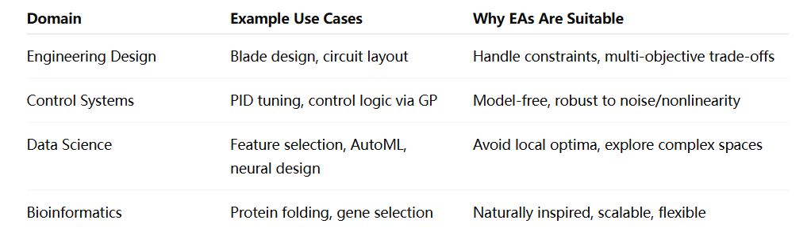
Typical Applications of Evolutionary Computation
Summary Table of Application Domains
"Where rules are unknown and objectives compete, evolution finds a way."
— Evolutionary computation thrives in unstructured, noisy, and complex worlds.

Slide 22
YOUR LOGO
05
Introduction to Graph Neural Networks and Case Studies

Slide 23
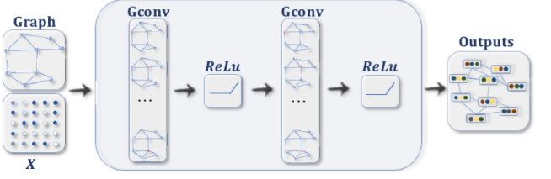
Graph Neural Networks (GNNs)
Graph Neural Networks (GNNs) are a class of deep learning models specifically designed to process and learn from graph-structured data. Unlike traditional neural networks that handle grid-like data (e.g., images) or sequential data (e.g., text), GNNs excel at capturing relationships and dependencies between interconnected entities, making them invaluable for tasks involving non-Euclidean data.

Slide 24
Definition and Basic Concepts
Definition of Graph Neural Networks
Key Components of GNNs
Advantages of GNNs
Graph Neural Networks (GNNs) are neural networks designed to operate on graph-structured data. They generalize traditional neural networks to handle data represented as graphs, where nodes represent entities and edges represent relationships between them. This allows GNNs to capture complex dependencies and interactions in the data.
The key components of GNNs include nodes, edges, and the graph structure itself. Nodes can have features, and edges can have weights or types. The graph structure defines how information is propagated between nodes. GNNs use message passing mechanisms to aggregate information from neighboring nodes and update node representations.
GNNs offer several advantages over traditional neural networks. They can handle irregular data structures, capture long-range dependencies, and are highly expressive. These properties make GNNs suitable for a wide range of applications, including social network analysis, molecular chemistry, and recommendation systems.

Slide 25
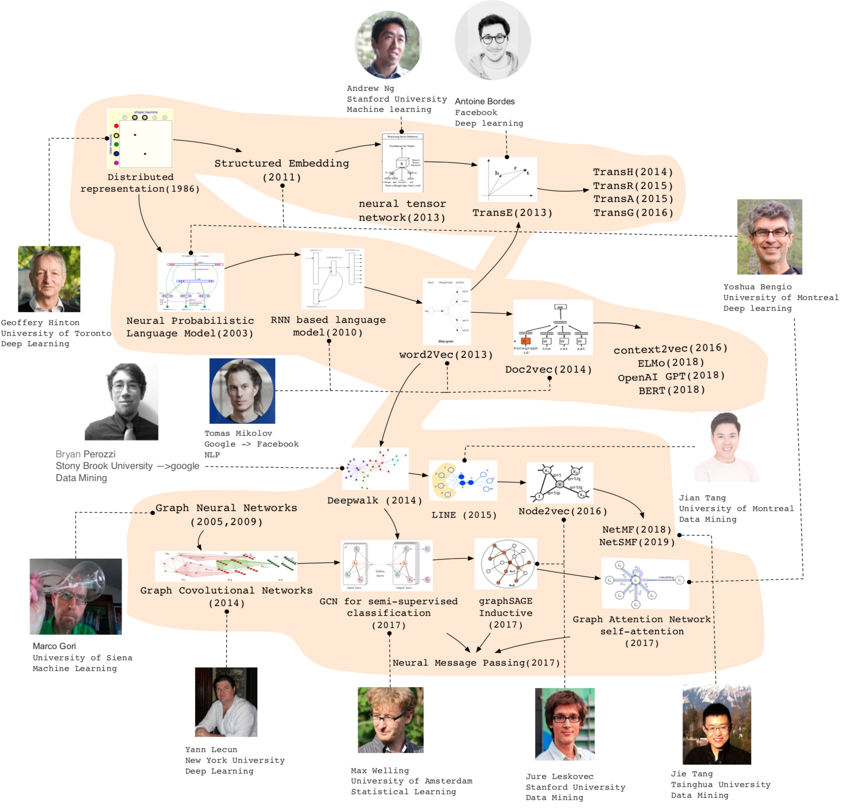
History of Graph Representation Learning

Slide 26

Future Work and Recommendations
01
Research and Development
Future work should focus on addressing the challenges of GNNs, such as scalability, overfitting, and interpretability. Developing more efficient algorithms, regularization techniques, and interpretable models will be crucial for the advancement of GNN research.
02
Practical Applications
In practical applications, it is important to carefully select and preprocess the data, choose appropriate GNN models, and evaluate their performance rigorously. Collaboration between researchers and practitioners will help bridge the gap between theoretical research and real-world applications.
Community and Collaboration
03
Building a strong community and fostering collaboration among researchers, developers, and practitioners will be essential for the growth and development of GNNs. Sharing knowledge, resources, and best practices will accelerate the progress and adoption of GNNs in various fields.

Slide 27
YOUR LOGO
06
Federated Learning and Data Privacy Protection

Slide 28
Foundations and Motivation of Federated Learning
Definition: A distributed machine learning paradigm where data remains local, and only model updates (e.g., gradients or weights) are shared with a central server.
Why Federated Learning?
Data privacy regulations (e.g., GDPR, HIPAA)
Data silos (e.g., hospitals, banks)
Edge intelligence: computation on mobile/IoT devices

Slide 29
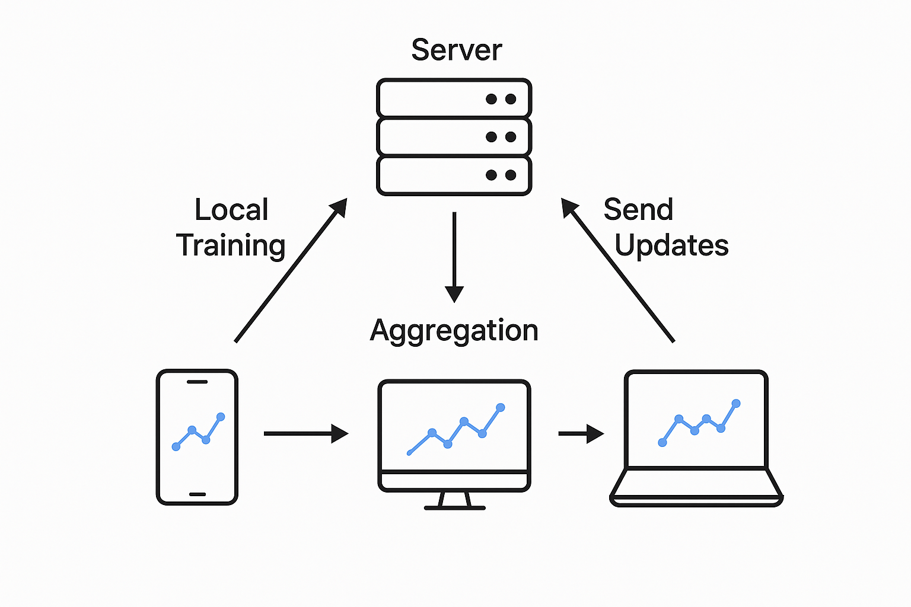
​​Key Components
Client: owns local data, trains model locally
Server: coordinates training, aggregates updates
Communication rounds: global aggregation cycle
This diagram shows the basic workflow of Federated Learning:
Multiple clients (like smartphones and laptops) train models locally without sharing raw data.
They send model updates to the central server.
The server aggregates the updates to create a new global model and distributes it back.
This loop repeats to enable privacy-preserving collaborative learning."

Slide 30
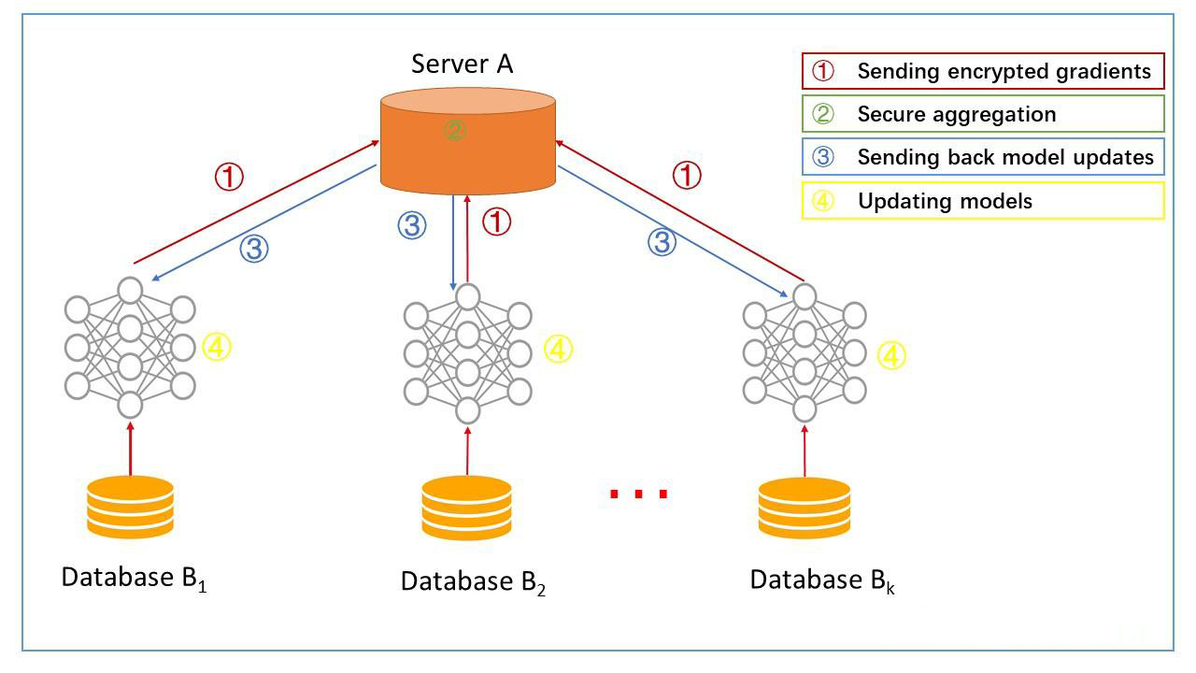
Federated Learning
Federated Learning (FL) is a distributed machine learning paradigm designed to train models across multiple decentralized devices or servers while keeping data localized. Unlike traditional centralized approaches—where data is aggregated into a single server—FL enables model training on edge devices (e.g., smartphones, IoT sensors) or local data centers, with only model updates (e.g., gradients, weights) shared between participants. This preserves data privacy, making it ideal for sensitive domains like healthcare, finance, and personal devices.

Slide 31
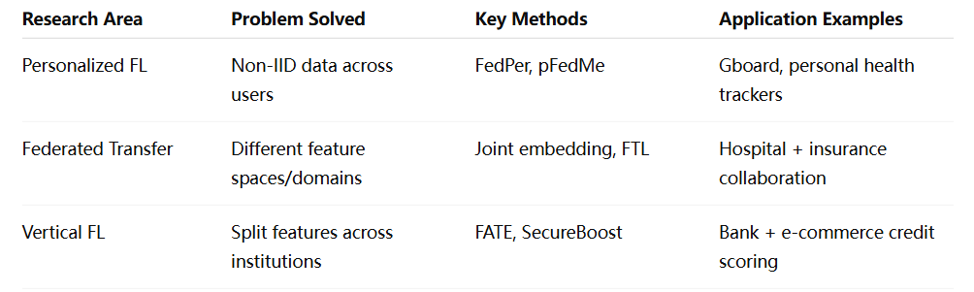
​​Where is FL going next?

Slide 32
YOUR LOGO
07
Quantum Computing and Intelligent Computing Convergence

Slide 33
The Convergence of Quantum Computing and Artificial Intelligence
Quantum computing, a new computing model based on quantum mechanics, demonstrates enormous potential to outperform classical computers.
Leveraging properties like quantum superposition and entanglement, it can achieve exponential speedups in specific problems.
This powerful parallel computing capability enables quantum computers to tackle complex issues that classical computers struggle with or cannot solve, injecting new vitality into AI development.
The integration of quantum computing and AI is regarded as a key driver of the next-generation computing power revolution, promising disruptive breakthroughs across multiple fields

Slide 34
Basic Principles of Quantum Computing
Quantum Bits and Superposition
Quantum bits, or qubits, can exist in superposition states, allowing quantum computers to process vast amounts of data simultaneously. This enables parallel processing capabilities far beyond classical computers. For example, a system with just 300 qubits can represent more states than there are atoms in the observable universe.
Quantum Entanglement and Its Applications
Quantum entanglement allows qubits to be interconnected regardless of distance, enabling instantaneous communication and correlation. This property is crucial for quantum computing and is used in applications like quantum cryptography to create secure communication channels.
Quantum Gates and Circuits
Quantum gates are the building blocks of quantum circuits, manipulating qubits through specific operations. These gates enable the implementation of complex quantum algorithms, such as the quantum Fourier transform, which achieves exponential speedup over classical algorithms.

Slide 35
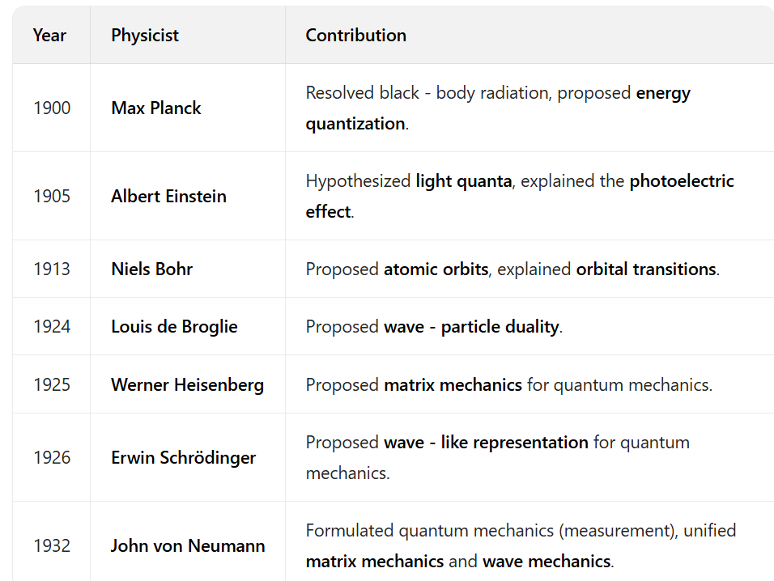
Timeline of Quantum Mechanics Milestones

Slide 36
Summary of Key Points
Recap of Quantum and Intelligent Computing Integration
Importance of Addressing Challenges
Future Opportunities and Collaborations
The integration of quantum computing and intelligent computing offers significant benefits, including exponential speedup and advanced algorithms. This has the potential to revolutionize various fields.
Addressing technical challenges like error correction, scalability, and integration is crucial for realizing the full potential of quantum computing. Ethical and societal implications must also be considered.
Advancements in quantum hardware, the development of hybrid systems, and global collaboration efforts will drive innovation and adoption of these technologies.

Slide 37
YOUR LOGO
08
Big Data Modeling and Analysis Methods

Slide 38
Big Data Modeling and Analytical Methods
Big data modeling and analysis refer to the processes of structuring large, complex datasets (characterized by volume, velocity, variety, veracity, and value) and extracting actionable insights using statistical, computational, and machine learning techniques.
Characteristics of Big Data — The 5Vs
Volume: Huge size — terabytes, petabytes, or more.
Velocity: Speed at which data is generated (e.g., real-time trading).
Variety: Structured, semi-structured (JSON), and unstructured (images, video, text).
Veracity: Data uncertainty and quality issues.
Value: Low-value density — useful insight is often buried under noise.ty

Slide 39
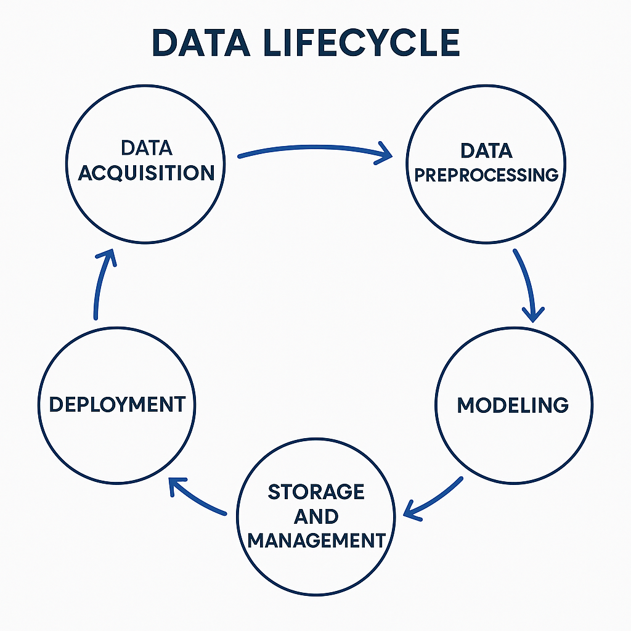
​​Big Data Analysis Workflow
Explain the six key stages in a typical big data analysis pipeline:
Data Acquisition: APIs, log files, sensors, crawlers.
Data Preprocessing: Cleaning, deduplication, missing value handling, feature extraction.
Storage and Management: Distributed storage systems (HDFS), NoSQL databases.
Modeling: Applying appropriate machine learning/statistical models.
Evaluation: Using metrics like accuracy, AUC, F1-score, cross-validation.
Deployment: Model integration into production (e.g., via APIs or dashboards).

Slide 40


​​Supervised Learning: Basic Concept
📱 Basic Concept
Supervised learning is a type of machine learning where the model is trained using labeled data — that is, each input is paired with a known output.
The goal is for the model to learn a mapping from inputs to outputs so it can predict outcomes for new, unseen data.
📱 Example:
Given historical housing data (with features like area and number of rooms, and known prices), a supervised learning model can learn to predict the price of a new house.

Slide 41
YOUR LOGO
09
Intelligent Systems Integrated Design Case Studies

Slide 42



Definition and Scope
Definition Core
Evolutionary Path
Application Areas
Intelligent systems are advanced technologies that mimic human intelligence to perform tasks. They integrate machine learning, natural language processing, and computer vision to solve complex problems efficiently.
These systems are widely used in healthcare, finance, transportation, and manufacturing. They enhance decision-making, automate processes, and improve user experiences through personalized interactions.
The evolution of intelligent systems has progressed from rule-based systems to machine learning models and now to deep learning architectures. This progression has significantly increased their capabilities and adaptability.

Slide 43
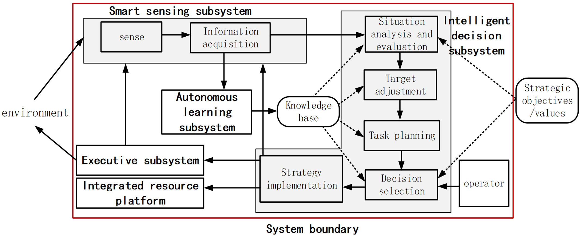
Definition and Scope

Slide 44
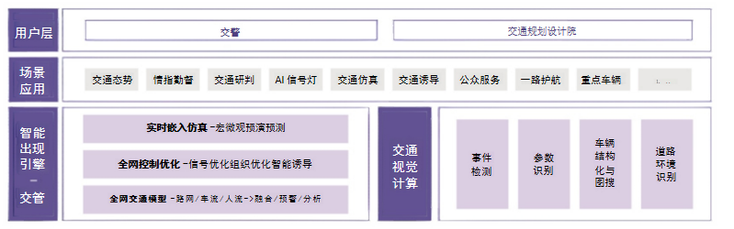
City Brain: Urban Traffic Governance Solution

Slide 45
Summary of Key Points
Comprehensive Overview
This presentation has provided a comprehensive overview of intelligent systems, including their components, design principles, and a case study. It has highlighted the importance of these systems in various applications.
Future Outlook
The future of intelligent systems looks promising with advancements in AI, integration with IoT, and ethical considerations. These systems will continue to transform industries and improve our lives.
Continuous Improvement
Continuous improvement and adaptation are essential for intelligent systems. This involves staying updated with technological advancements and addressing emerging challenges.

Slide 46
YOUR LOGO
THANK YOU
汇报人:
时间:2025.01.01

